Slide 1

ONLINE CAR DEALERSHIP SYSTEM
STUDENTS NUMBER:
1.122790……… conceptual framework, system sequence
2.121041,,,,,,,,,,database schema, problem statement
3.120894…….requirement specification, context level diagram
4.122909……. Use-case diagram,
5.105391……..dataflow diagram, unified modelling language.
6.122266……..architectural design.

Slide 2
PROBLEM STATEMENT
In the current market car prices are exaggerated due to the long supply chain.
Our proposed system aims to shorten the supply chain by implementing trustworthiness, hence reducing the prices of the cars and making them affordable. This will enable the consumers to have a direct link to their suppliers and hence built credibility between the buyer and the seller.

Slide 3
FUNCTIONAL REQUIREMENT
Function | Provision of car history
Description | Detailed information of the car manufacturers and years in use if second hand
Input | Buyers details (names) and the location
source | Car-dealership company
Output | History of the car logbook details
Destination | The buyer (consumer)
action | Purchase terms and conditions have to be met in accordance with the license agreement
Pre-condition | Agreement of the terms and conditions both buyer and seller.
Post-condition | Terms and condition agreement
Car history provision
Car billing
Car verification

Slide 4



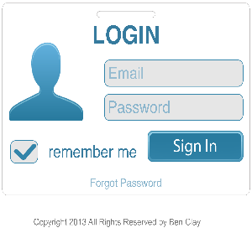
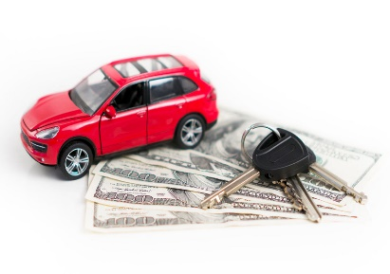


CONCEPTUAL FRAMEWORK
Payment receipt
User details
Car issuance to user
Payment details
verification
Option:
Buy and sell
User requisition
Requisition confirmation
Requisition handling
Car payment
Confirmation of user details

Slide 5

ARCHITECTURAL DESIGN
CLIENT
Employee
Car evaluation
Customer
Buy or sell a car
Payments
SERVER
Gives the option of buy or sell
Request processing
Car issuance
Facilitate billing processes
Car price computation

Slide 6
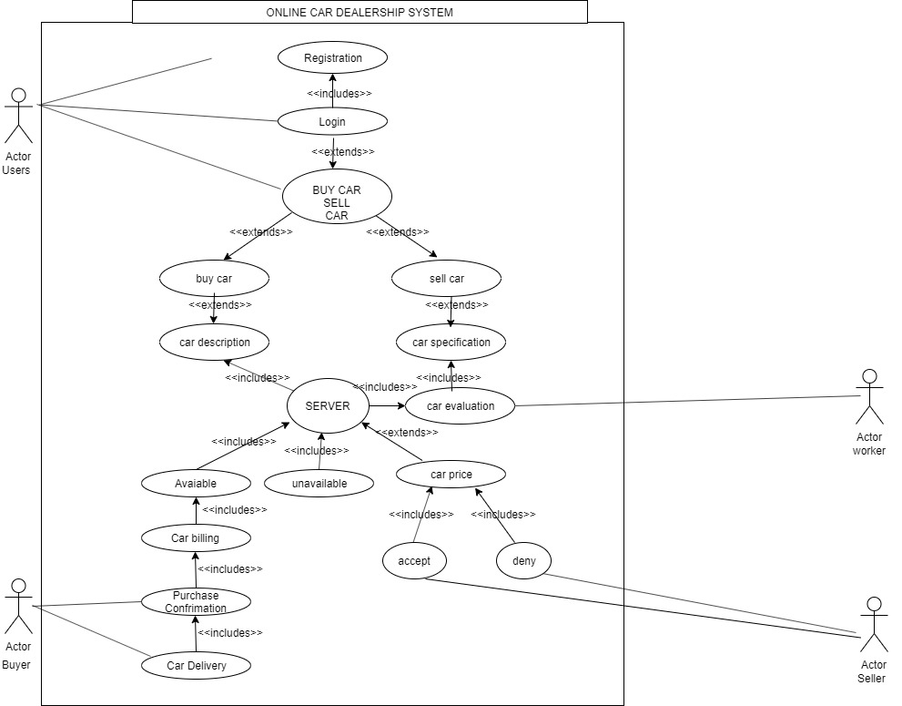

Slide 7
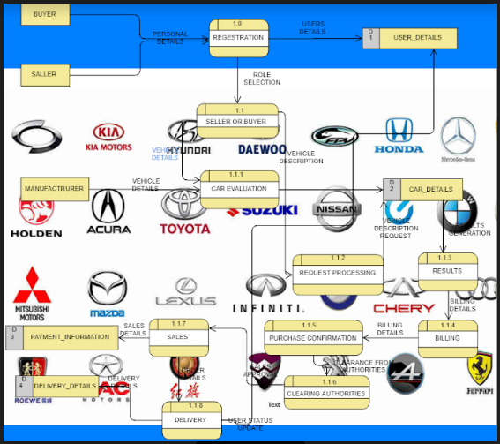

Slide 8
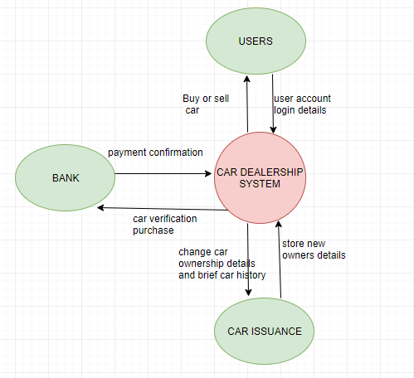
CONTEXT LEVEL DIAGRAM (LEVEL 0)

Slide 9
UML CLASS DIAGRAM
customer
-UserName: String
-email: String
-Address: String
user
Car_price
-userID: String
-password: String
-LoginStatus: String
-car description: String
-car price: Double
+register()
+login()
+profile update()
+AgreePrice()
+ CheckOut()
VerifyLogin(): bool
Payment method
sell_car
Buy_car
-car amount: double
-payment option: string
-payment period: string
-car type: string
-car description: string
-cust_name: string
-cust_ID: string
-car type: string
-car description: string
-date ordered: string
+AddItem()
+ViewItem()
+checkout()
+ payment ID()
+payment Receipt ()
+viewPrice ()

Slide 10
SYSTEM SEQUENCE DIAGRAM
Car issuance
Customer
Registration
Server
Buy
Bank
1.0 (user details)
1.1 (confirm message)
2.0 (buy a car )
2.1 (request handling)
2.2 (car description)
2.2.1 (available or not)
Loop n=available
3.0 (amount + payment details)
3.1 (user feedback)
3.1.1(payment ID)
3.1.2(payments )
3.1.3(payment receipt)
4.0(car issue)
3.1.3(payment verification)
4.1(car issue + changing log book details)
3.1.4(payment confirmation)

Slide 11
DATABASE SCHEMA
BANK
Payment option
Transaction ID
Payment agreement
USER
Username:
Password:
Phone number:
Email:
User_ID: P.K
SERVER
Name:
Email address
User ID : P.K
Transaction ID
PAYMENT METHOD
Car amount
Payment ID : PK
Payment option
Payment ID
CAR ISSUANCE
Customer name:
Car History
SELL CAR
Car description
Car type
Customer name
Customer ID
BUY CAR
Car description
Car type

